Slide 1
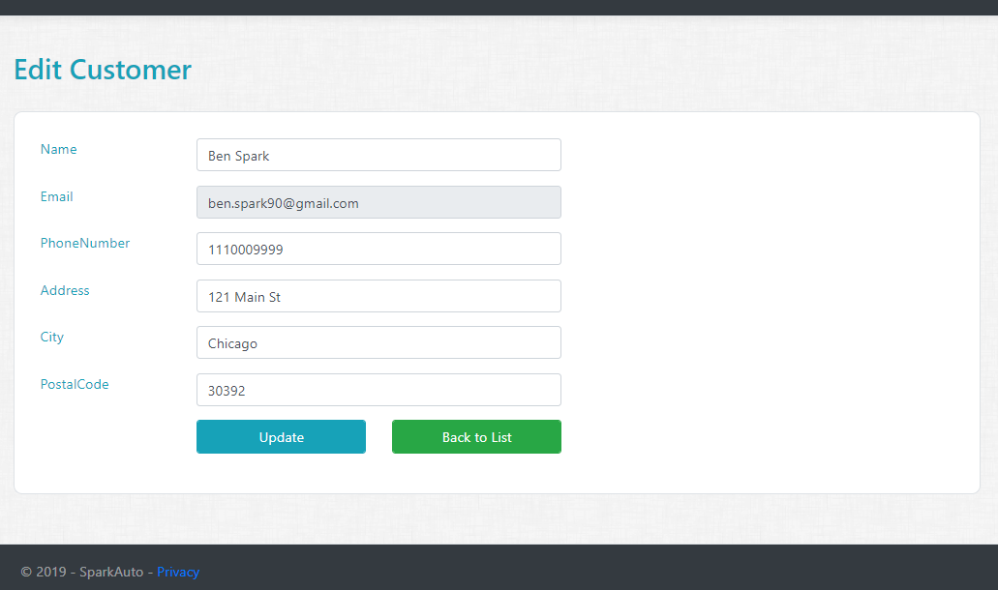
Assignment 3
User Edit Razor Page
Create Edit User Razor Page with Page model and add GET handler.
Modify Edit User Razor Page (UI) and design the page.
HINT : Get handler will receive User ID (string).
Modify Edit User Razor Page model and add POST Handler.
HINT : Take advantage of Bind Property and Email should not be editable.

Slide 2
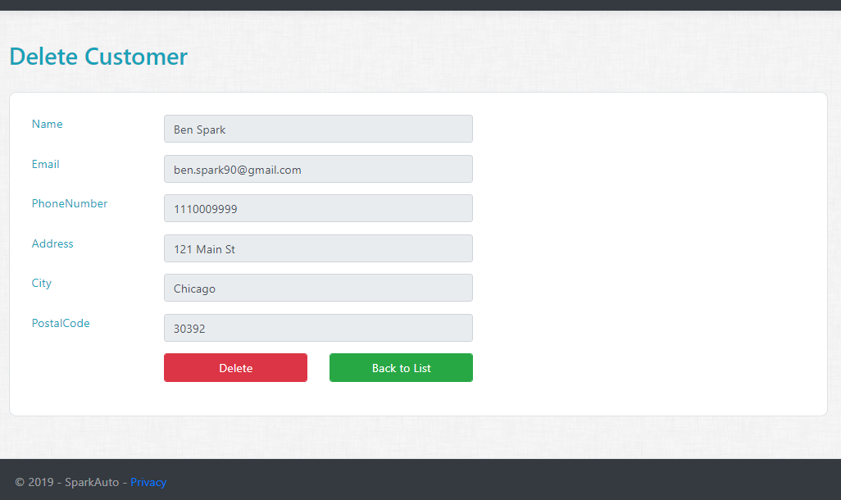
Assignment 4
User Delete Razor Page
Create Delete User Razor Page with Page model and add GET handler.
Modify Delete User Razor Page (UI) and design the page.
HINT : Get handler will receive User ID (string).
Modify Delete User Razor Page model and add POST Handler.
HINT : Take advantage of Bind Property.

